Slide 1
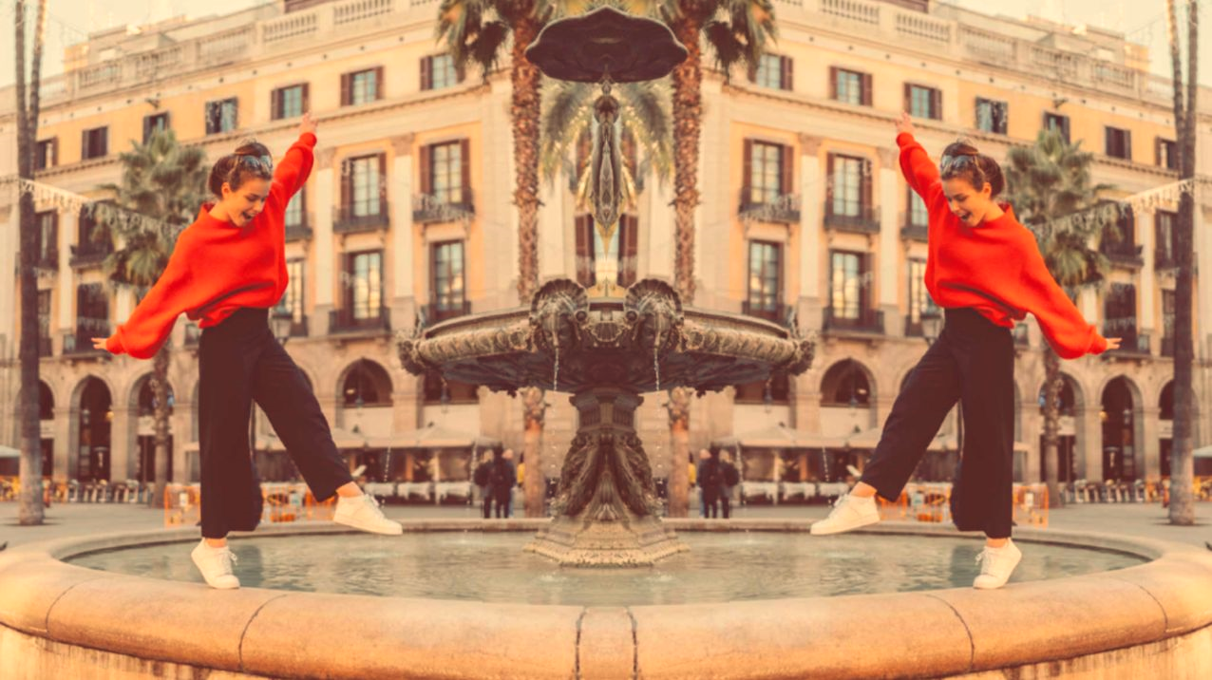


UNIT 2; Inspired
Lesson 8; Upcycling

Slide 2
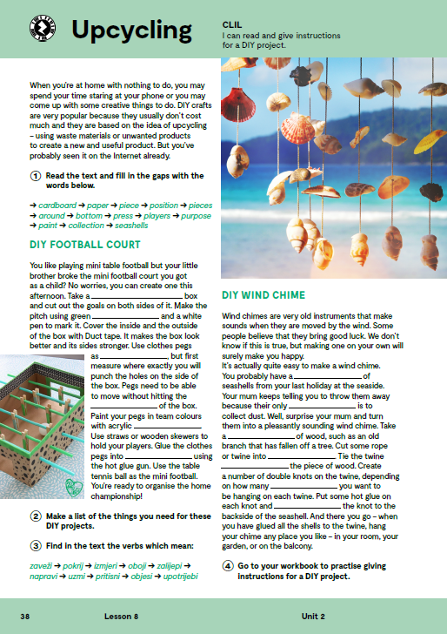
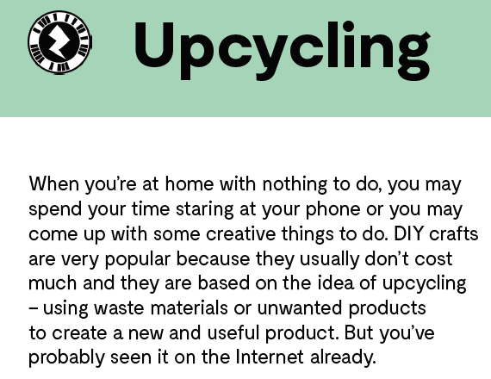
Drag and drop the pins to their correct place on the image. https://wordwall.net/play/12636/749/132
Read the text and think. What is UPCYCLING?
One man’s trash is another man’ s treasure!

Slide 3
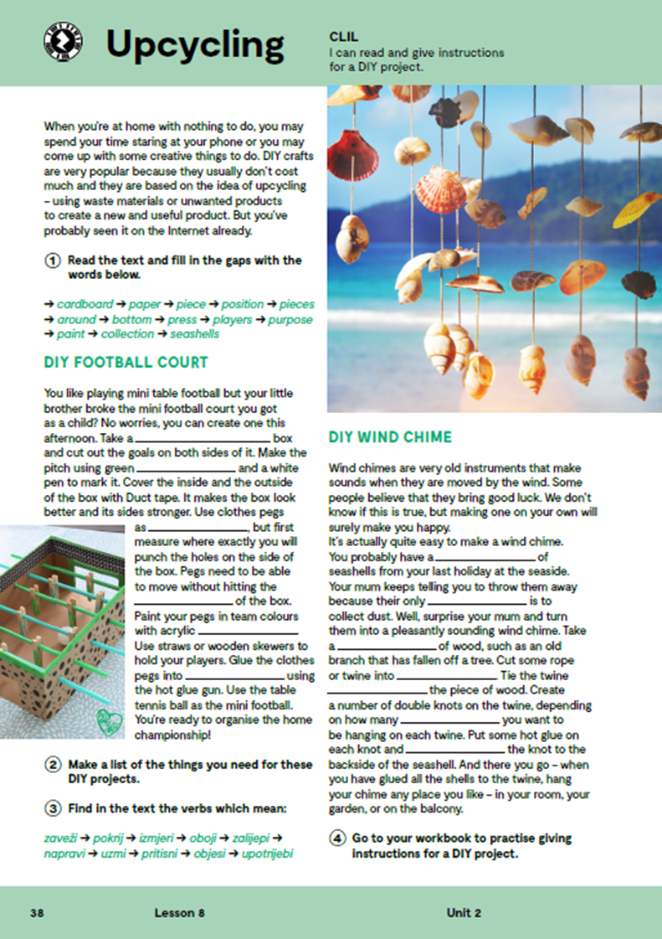
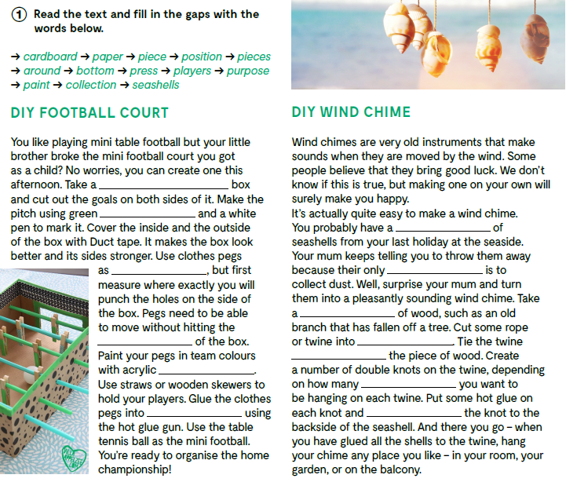
cardboard
paper
collection
players
purpose
piece
bottom
pieces
around
paint
seashells
position
press

Slide 4

DIY FOOTBALL COURT
cardboard box – kartonska kutija
green paper
white pen
duck tape – ljepljiva traka
clothes pegs – kvačice za rublje
acrylic paint – akrilna boja
straws or wooden skewers – slamke ili drveni ražnjići za meso
hot glue gun – pištolj za vruće ljepilo
table tennis ball
DIY WIND CHIME
seashells – školjke
piece of wood / old branch
rope or twine – konopac ili uže
hot glue

Slide 5
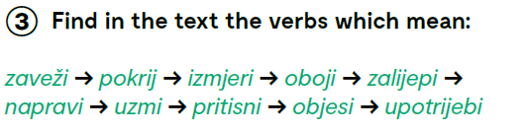
zaveži - tie
pokrij - cover
izmjeri - measure
oboji - paint
zalijepi - glue
napravi – make, create
uzmi - take
pritisni - press
objesi - hang
upotrijebi – use

Slide 6
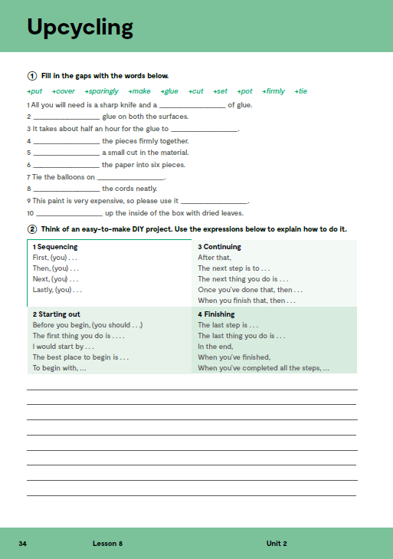
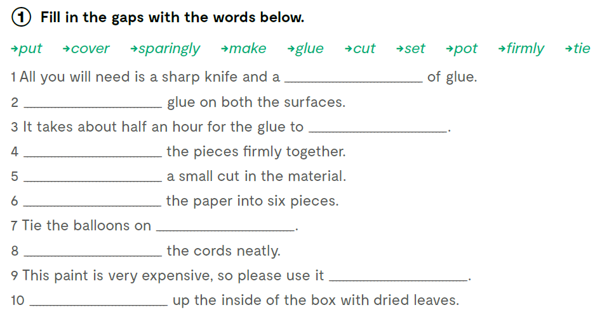
pot
Put
set
Glue
Make
Cut
firmly
Tie
sparingly
Cover

Slide 7
